Slide 1
Biopharma
Technical Assessment
IT Developer
Ful

Slide 2
Mini Project

Slide 3
Preparations
Coding environment tool.
Notes (if needed).

Slide 4
Criteria
Solve the issue using .NET and Next JS.
Solve the issue within the mentioned duration of time.
Scoring priority:
Functional
UI & UX
Security
Unit/Integration Tests
Logging
QoL

Slide 5
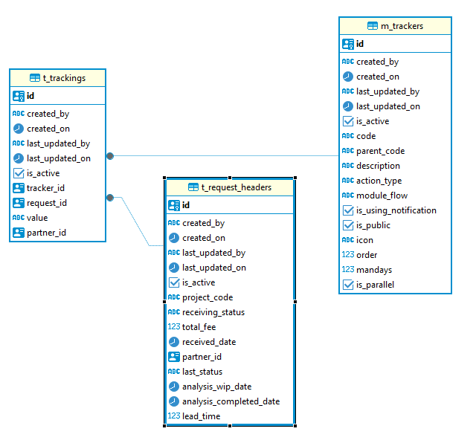
Database - Diagram

Slide 6
Issue
Based on Database’s diagram, create a web app for CRUD (create, read, update, delete) based on these designs:
(Note: You can improve the designs as needed)
Features:
1. Auth
2. CRUD Master Trackers
3. CRUD Transaction Requests
4. Logging (create your own backend using .NET)
5. CRUD Transaction Trackings (bonus for FE)
6. Audit Trail (bonus for BE)

Slide 7
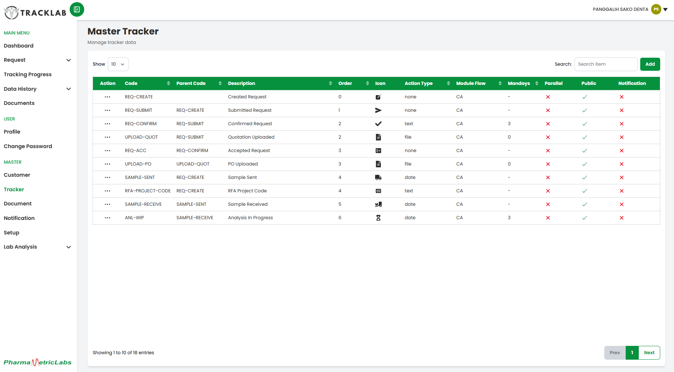
Master - Trackers

Slide 8
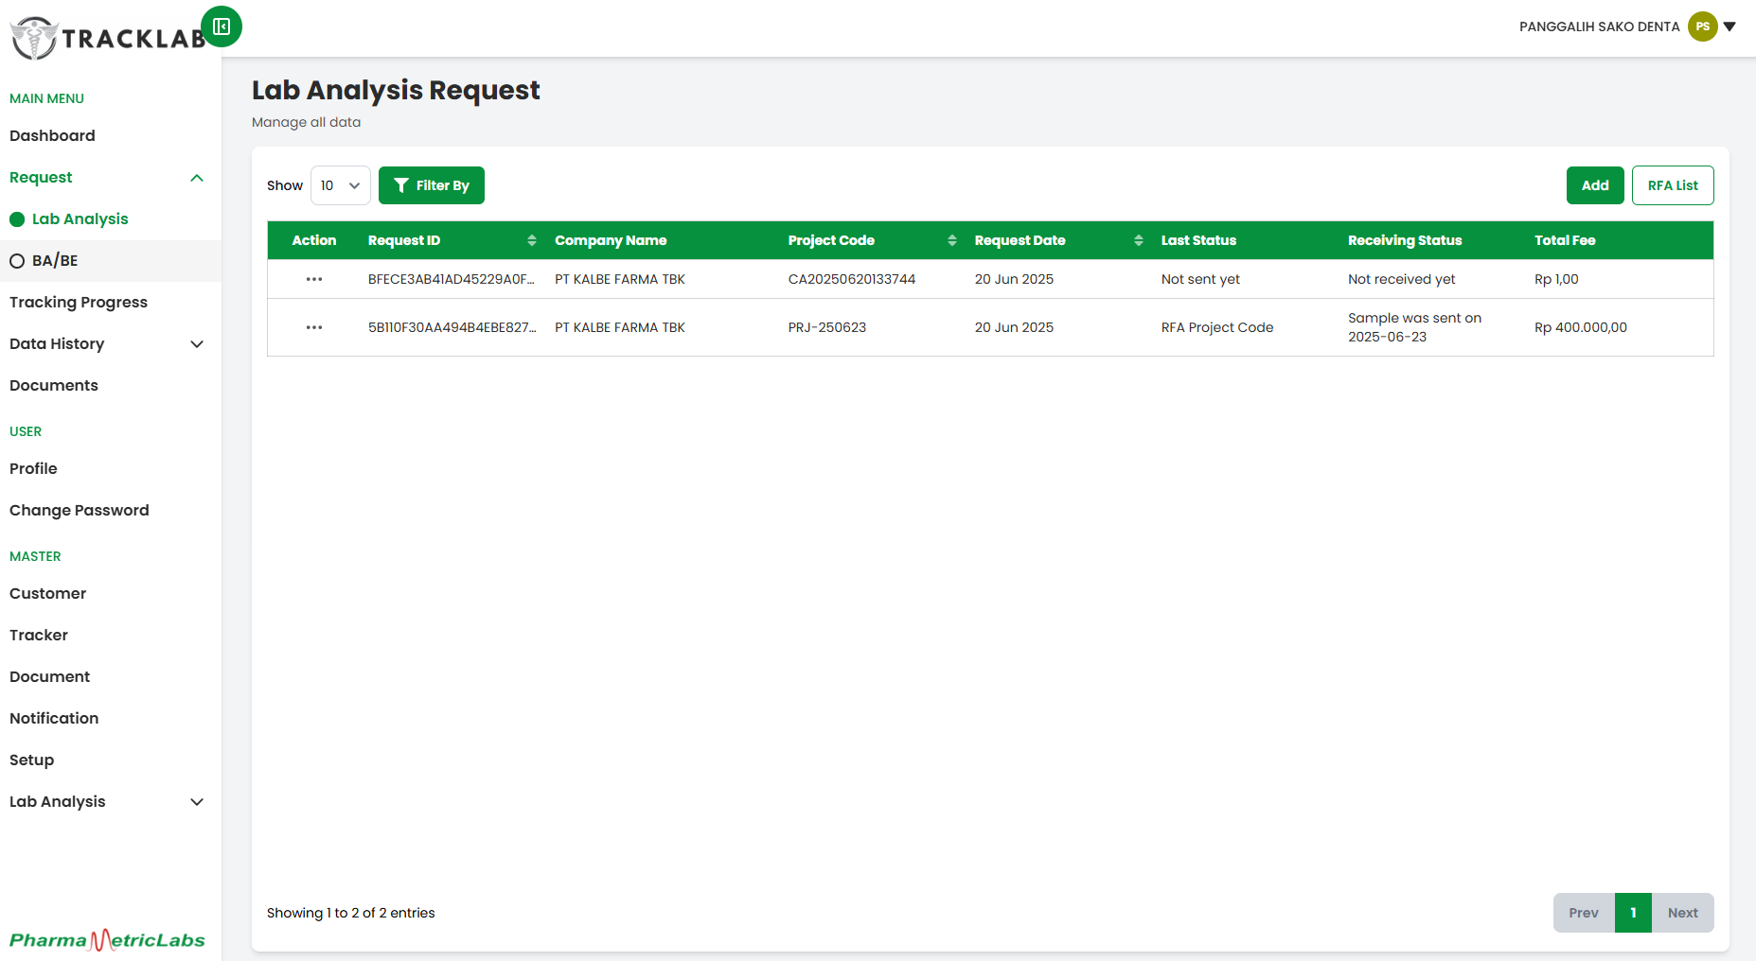
Transaction - Requests

Slide 9
API Docs - Basic Information
Base URL:
https://api-assessment-biopharma.kalbe.co.id
Auth Path:
/api/v1/authentication
Main Features Path:
/api/v1/feature
Main Features Docs:
Postman

Slide 10
API Docs - Auth
App Auth Headers:
app_id=41e4f05a
app_key=306db443aa95cecd671214b806bb31ef
Auth Headers:
Authorization=Bearer {access_token}
Refresh Token: pass back the refresh token cookie from the login response to get the new access token
All of endpoints need Authorization with access bearer token passed except for log in

Slide 11
API Docs - Auth
Log In: [POST] /auth/login
{
"appCode": "ASSESSMENT",
"moduleCode": "ALL",
"user": "assessment.it",
"password": "Password123?"
}
Log Out: [POST] /auth/logout
{
"appCode": "ASSESSMENT",
"moduleCode": "ALL",
"user": “assessment.it"
}
Refresh Token: [GET] /auth/token/refresh?refreshAuthorization=true
* “refreshAuthorization” param can be adjusted with true or false as needed
Authorization (Roles & Modules): [GET] /auth/authorization?nested=false
* “nested” param can be adjusted with true or false as needed

Slide 12
API Docs – Paginations
Simple Pagination Headers:
X-Paging-Offset: (long) Start index (e.g., 0)
X-Paging-Limit: (long) Max number of records (e.g., 25)
X-Paging-SortBy: (string) Property name to sort by (e.g., trackerCode or converted to snake_case like tracker_code)
X-Paging-SortOrder: (string) ASC / DESC
X-Paging-Search: (string) Free-text search keyword
Advance Pagination Headers:
X-Paging-Offset: (long) Start index (e.g., 0)
X-Paging-Limit: (long) Max number of records (e.g., 25)
X-Paging-SortBy: (string) Property name to sort by (e.g., trackerCode or converted to snake_case like tracker_code)
X-Paging-SortOrder: (string) ASC / DESC
X-Paging-Operator: (string) AND / OR
X-Paging-IgnoreCase: (bool) true / false
X-Paging-Include: Base64-encoded JSON filters using property names ({ “tracker_code”: “REQ-ACC||REQ-CREATE”}), use “||” as the separator to search multiple values in the same field
X-Paging-Exclude: Base64-encoded JSON filters to exclude using property names ({“tracker_code”: “REQ-CANCEL||REQ-COMPLETE”}) , use “||” as the separator to search multiple values in the same field

Slide 13
API Docs – Paginations - Example
Simple Pagination Headers:
X-Paging-Offset= 0
X-Paging-Limit: 25
X-Paging-SortBy: id
X-Paging-SortOrder: ASC
X-Paging-Search: REQ-CREATE
Advance Pagination Headers:
X-Paging-Offset: 0
X-Paging-Limit: 10
X-Paging-SortBy: tracker_code
X-Paging-SortOrder: DESC
X-Paging-Operator: OR
X-Paging-IgnoreCase: true
X-Paging-Include: eyDigJx0cmFja2VyX2NvZGXigJ06IOKAnFJFUS1BQ0N8fFJFUS1DUkVBVEXigJ19
X-Paging-Exclude: bmFtZT1SZWphbA==

Slide 14
Thank You

